Slide 1
Ch12: Message Authentication Codes
Freshman Seminar
2022.01.25
Sumin Sohn

Slide 2
Contents
12.1 Message Authentication Requirements
12.2 Message Authentication Functions
12.3 Requirements for Message Authentication Codes
12.4 Security of MACs
12.5 MACs Based on Hash Functions: HMAC
12.6 MACs Based on Block Ciphers: DAA and CMAC
12.7 Authenticated Encryption: CCM and GCM

Slide 3
12.1 Message Authentication Requirements

Slide 4
Attacks on Communications Across a Network #1
Disclosure
Release of message contents to any person or process not possessing the appropriate cryptographic key
Traffic analysis
Discovery of the pattern of traffic between parties
E.g., frequency and duration of connections, the number and length of messages between parties

Slide 5
Attacks on Communications Across a Network #2
Source repudiation
Denial of transmission of message by source
Destination repudiation
Denial of receipt of message by destination
These are related to digital signature

Slide 6
Attacks on Communications Across a Network #3
Masquerade
Insertion of messages into the network from a fraudulent source
Creation of messages by an opponent
Fraudulent acknowledgments of message receipt or nonreceipt
Content modification
Changes to the contents of a message
Sequence modification
Modification to a sequence of messages between parties
Timing modification
Delay or replay of messages

Slide 7
Message Authentication vs Digital Signature
Message authentication verifies
Received messages come from the alleged source
And have not been altered
Digital Signature
Authentication technique that also includes measures to counter repudiation by the source

Slide 8
12.2 Message Authentication Functions

Slide 9
Types of Functions to Produce Authenticator
Authenticator
Value to be used to authenticate a message
Types
Hash function
Maps a message of any length into a fixed-length hash value
Message encryption
Ciphertext of the entire message
Message Authentication Code(MAC)
Function of the message and a secret key that produces a fixed-length value

Slide 10
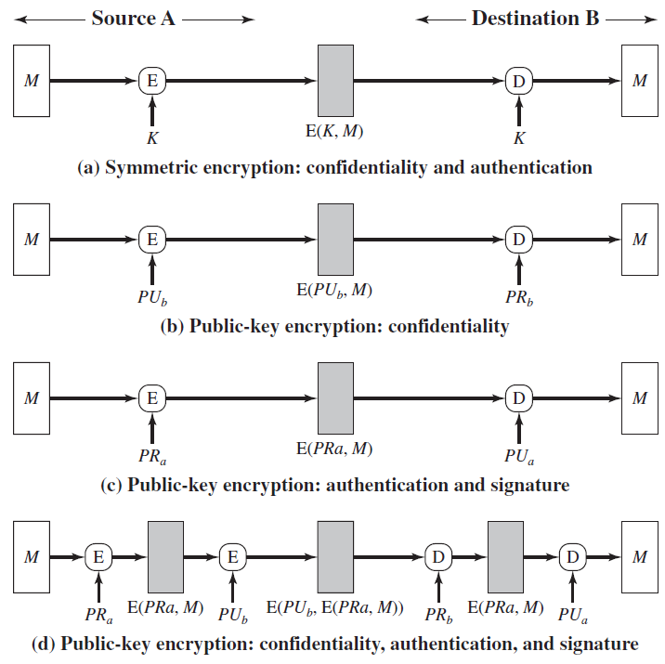
Uses of Message Encryption
Symmetric encryption
Public-key encryption

Slide 11
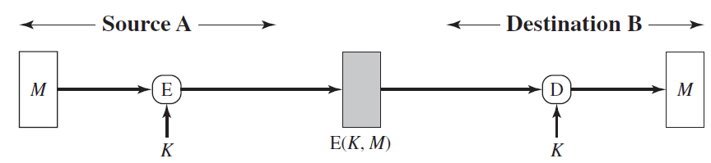
Symmetric Encryption
Message M is encrypted using a secret key K shared by A and B
Confidentiality
No other party can recover the plaintext of the message
Authentication
Message was generated by A
Opponent doesn’t know how to alter bits in the ciphertext to produce desired plaintext

Slide 12
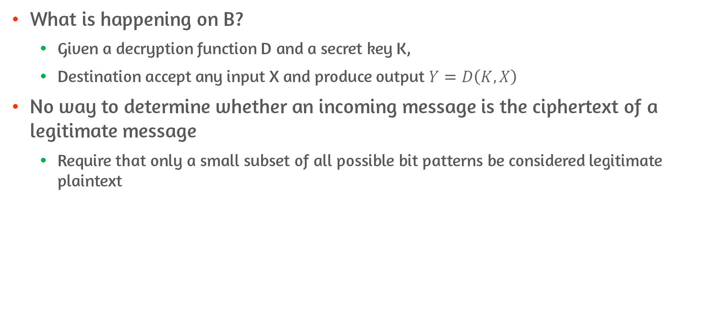
Problem of Authentication
What is happening on B?
Given a decryption function D and a secret key K,
Destination accept any input X and produce output $Y=D\left(K, X\right)$
No way to determine whether an incoming message is the ciphertext of a legitimate message
Require that only a small subset of all possible bit patterns be considered legitimate plaintext

Slide 13
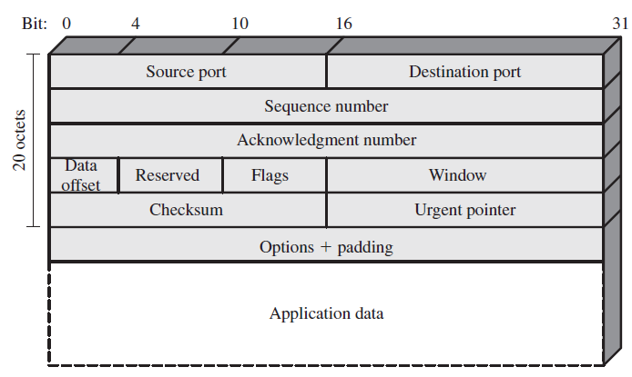
Solution to Authentication Problem
Force the plaintext to be
Easily recognized
But cannot be replicated without recourse to the encryption
Example 1: error detecting code
E.g., Frame Check Sequence(FCS) or checksum
If calculated FCS = incoming FCS, message is considered authentic
Example 2: structured message
E.g., structure of messages used for TCP/IP protocol
TCP segment

Slide 14
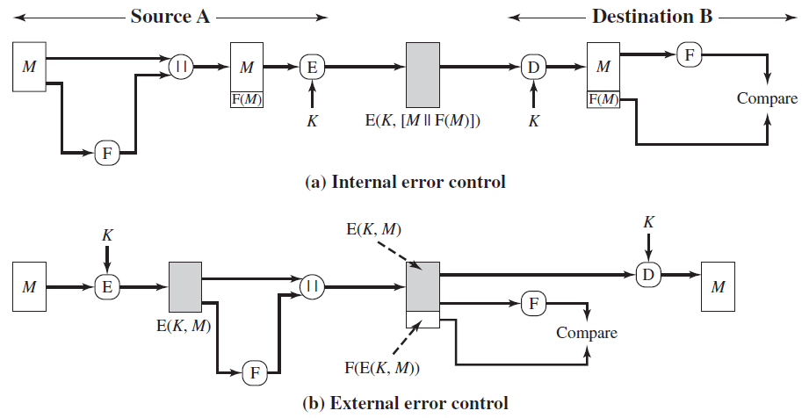
Order of FCS and Encryption Function
Internal error control
Authentication is provided
Opponent would have difficulty generating ciphertext
External error control
Opponent can construct messages with valid error-control codes
Cannot know decrypted plaintext
However, can create confusion and disrupt operations

Slide 15
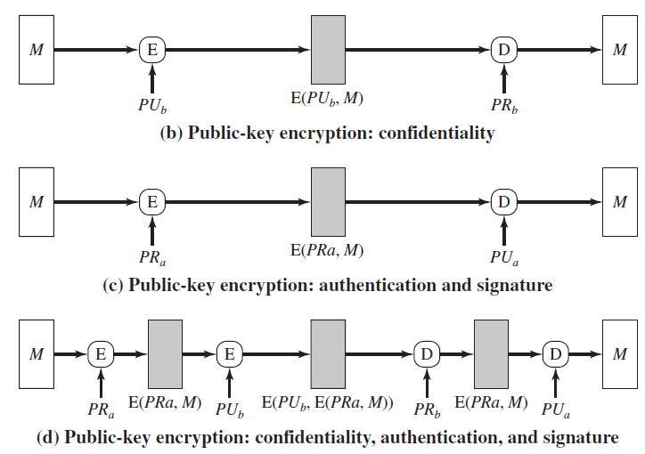
Public-Key Encryption: Type 1
Confidentiality O
Authentication X
Any opponent can encrypt a message using B’s public key

Slide 16
Public-Key Encryption: Type 2
Confidentiality X
Any opponent can decrypt ciphertext using A’s public key
Authentication O
Only A can encrypt a message
Digital Signature O
B has means to prove that message come from A

Slide 17
Public-Key Encryption: Type 3
Confidentiality O
Using B’s public key
Authentication O
Digital Signature O
Using A’s private key
Need 4times of public key encryption/decryption

Slide 18
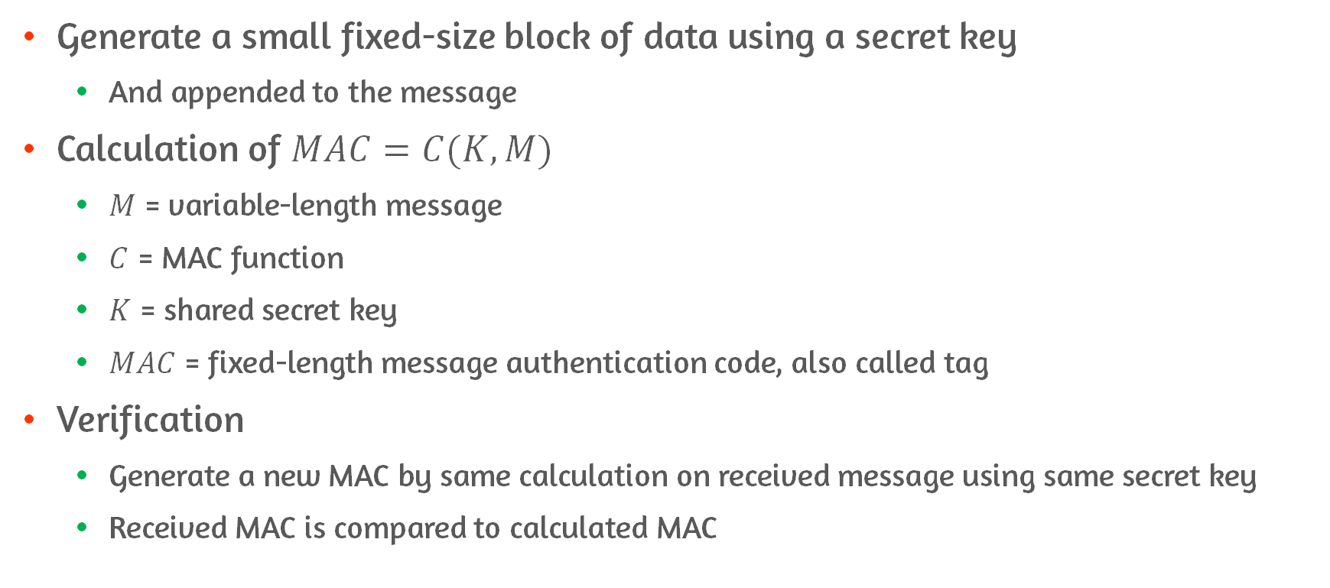
Message Authentication Code(MAC)
Generate a small fixed-size block of data using a secret key
And appended to the message
Calculation of $MAC=C(K, M)$
$M$ = variable-length message
$C$ = MAC function
$K$ = shared secret key
$MAC$ = fixed-length message authentication code, also called tag
Verification
Generate a new MAC by same calculation on received message using same secret key
Received MAC is compared to calculated MAC

Slide 19
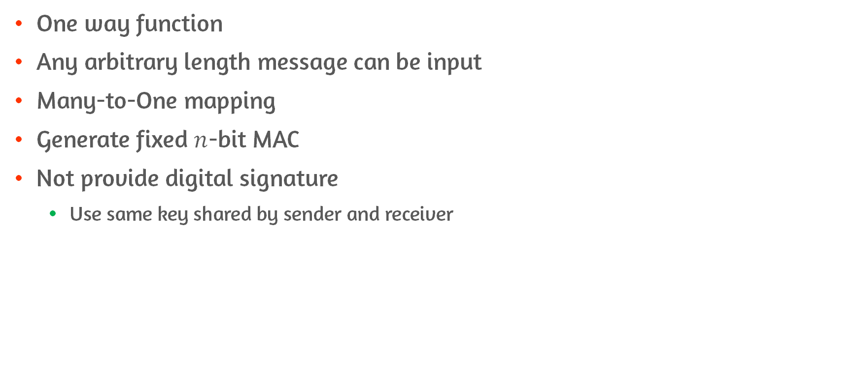
Features of MAC function
One way function
Any arbitrary length message can be input
Many-to-One mapping
Generate fixed $n$-bit MAC
Not provide digital signature
Use same key shared by sender and receiver

Slide 20
What Is Assured by MAC?
Message has not been altered
Attacker cannot alter the MAC to correspond to the alterations in the message
Message is from the alleged sender
No one else knows the secret key
If message includes a sequence number, can be assured of the proper sequence
Attacker cannot successfully alter the sequence number

Slide 21
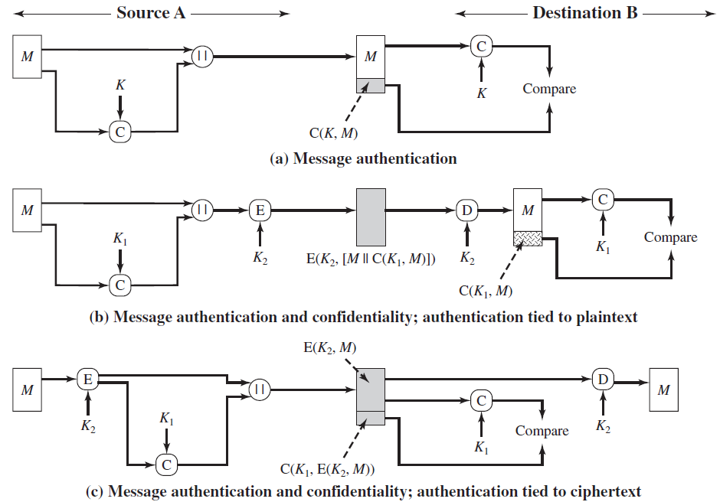
Uses of MAC
Not performing encryption: case (a)
Message M is transmitted in the clear
Performing encryption: case (b) and (c)
Use two separate keys shared by A and B
One for MAC
The other for encryption
Case (b)
Plaintext M || MAC
Entire block is encrypted
Case (c)
Message is encrypted first
Ciphertext || MAC from ciphertext
Notes:
Padding oracle attack

Slide 22
Why Use MAC Instead of Symmetric Cryptosystem?
Same message is broadcast to a number of destinations
E.g., alarm signal in a military control center
One side has a heavy load and cannot afford the time to decrypt all incoming messages
Authentication is carried out on a selective basis
Authentication of a computer program in plaintext
Computer program can be executed without having to decrypt it every time
No concern to keep messages secret, but important to authenticate messages
E.g., Simple Network Management Protocol Version 3 (SNMPv3)
No need to conceal SNMP traffic, but need to authenticate incoming message
Notes:
사실 symmetric encryption을 통해서도 authentication이 가능한데 왜 굳이 MAC을 쓰는가?

Slide 23
12.3 Requirements for Message Authentication Codes

Slide 24
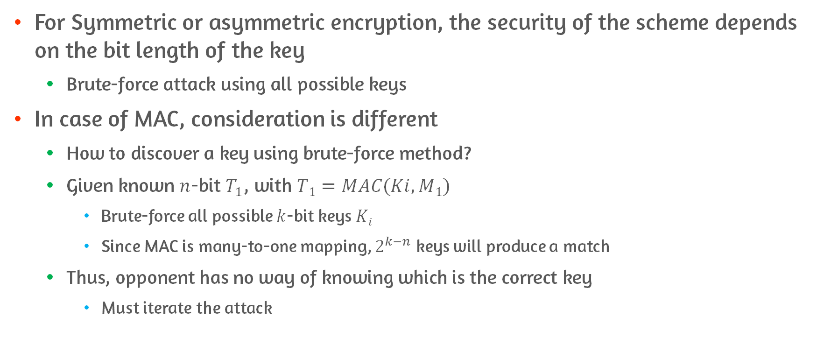
Consideration on MAC
For Symmetric or asymmetric encryption, the security of the scheme depends on the bit length of the key
Brute-force attack using all possible keys
In case of MAC, consideration is different
How to discover a key using brute-force method?
Given known $n$-bit $T_{1}$, with $T1=MAC(Ki, M1)$
Brute-force all possible $k$-bit keys $Ki$
Since MAC is many-to-one mapping, $2^{k−n}$ keys will produce a match
Thus, opponent has no way of knowing which is the correct key
Must iterate the attack
Notes:
여기서의 공격들은 사실 상 plaintext-tag 쌍일 때 좀 더 가치가 있음
원하는 메시지로 바꿀 수 있을테니까

Slide 25
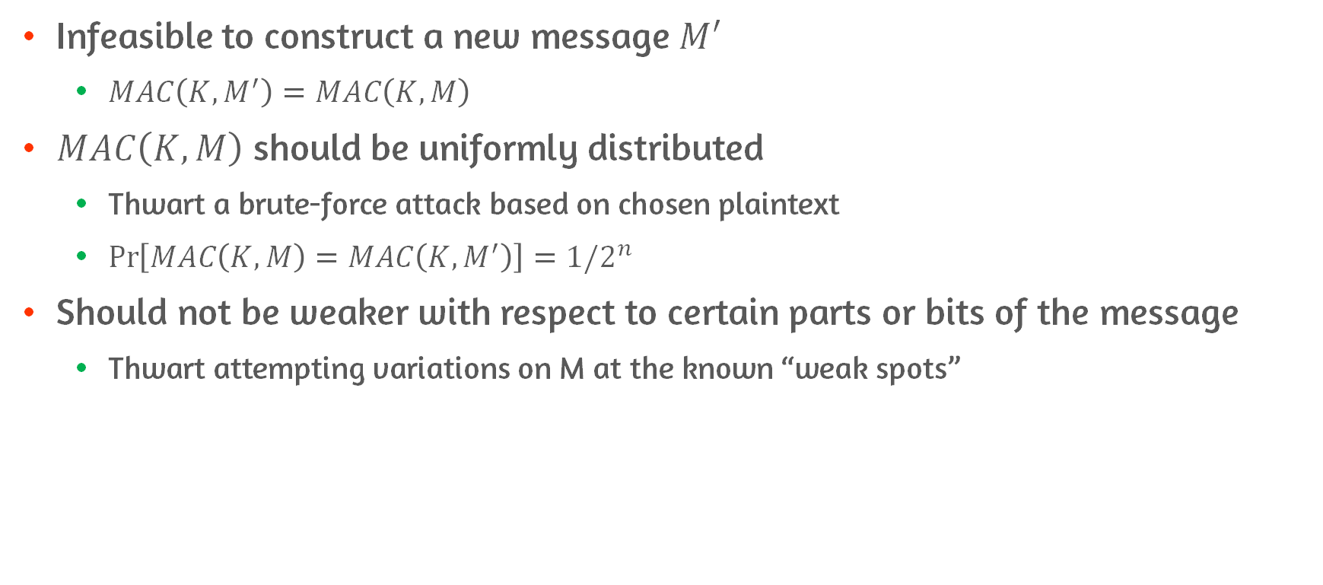
Requirements of MAC function
Infeasible to construct a new message $M′$
$MAC\left(K, M^{′}\right)=MAC\left(K, M\right)$
$MAC\left(K, M\right)$ should be uniformly distributed
Thwart a brute-force attack based on chosen plaintext
$\operatorname{Pr}\left[MAC\left(K, M\right)=MAC\left(K, M^{′}\right)\right]=1/2^{n}$
Should not be weaker with respect to certain parts or bits of the message
Thwart attempting variations on M at the known “weak spots”

Slide 26
12.4 Security of MACs
Group attacks on MACs into 2 categories: brute-force and cryptanalysis

Slide 27
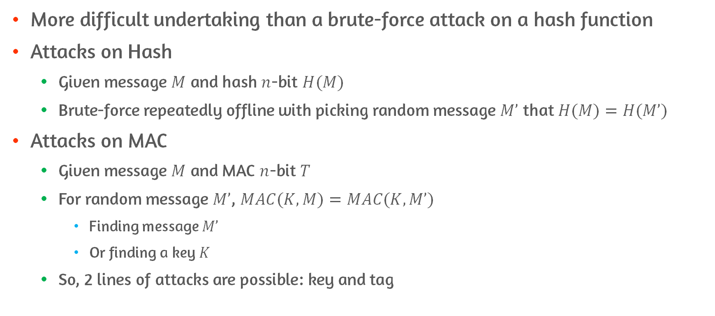
Brute-Force Attacks
More difficult undertaking than a brute-force attack on a hash function
Attacks on Hash
Given message $M$ and hash $n$-bit $H(M)$
Brute-force repeatedly offline with picking random message $M’$ that $H(M)=H(M’)$
Attacks on MAC
Given message $M$ and MAC $n$-bit $T$
For random message $M’$, $MAC(K, M)=MAC(K, M’)$
Finding message $M’$
Or finding a key $K$
So, 2 lines of attacks are possible: key and tag

Slide 28
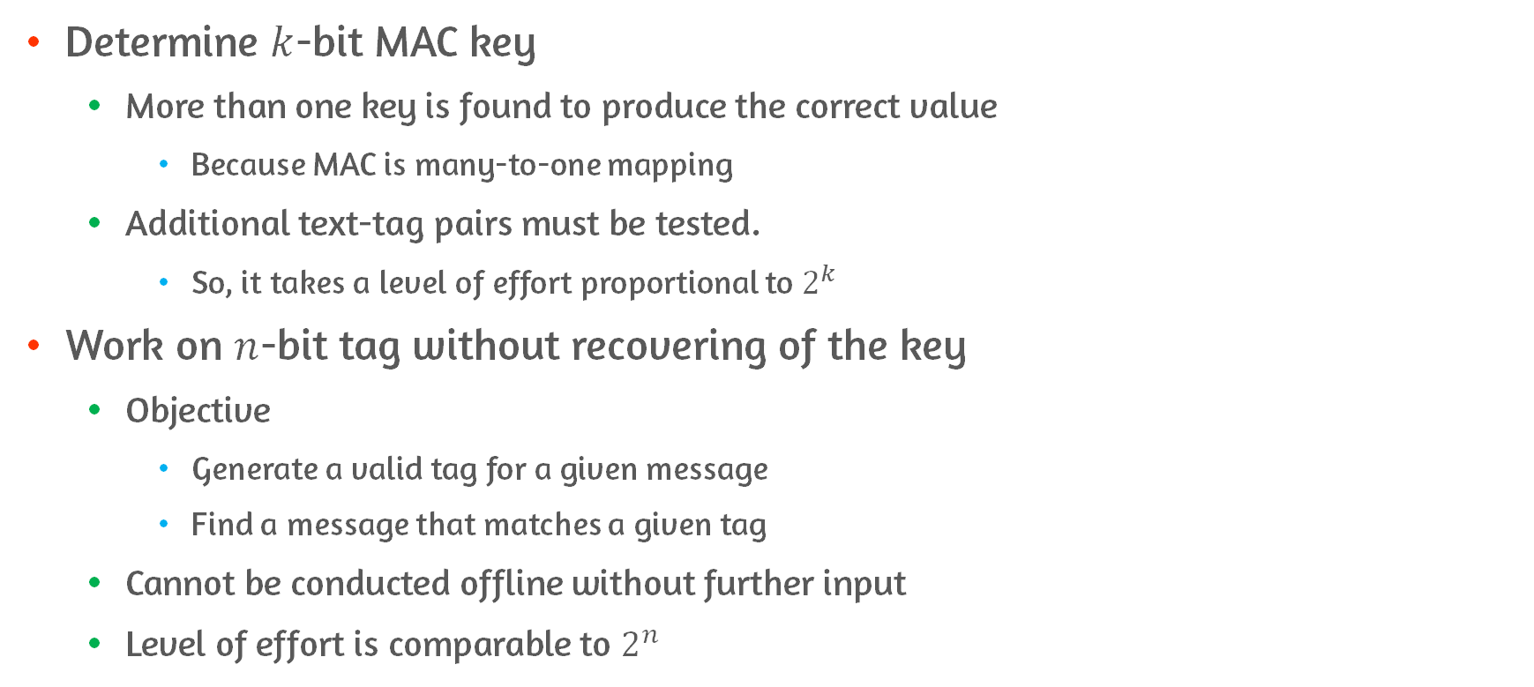
Description of Brute-Force Attacks
Determine $k$-bit MAC key
More than one key is found to produce the correct value
Because MAC is many-to-one mapping
Additional text-tag pairs must be tested.
So, it takes a level of effort proportional to $2^{k}$
Work on $n$-bit tag without recovering of the key
Objective
Generate a valid tag for a given message
Find a message that matches a given tag
Cannot be conducted offline without further input
Level of effort is comparable to $2^{n}$

Slide 29
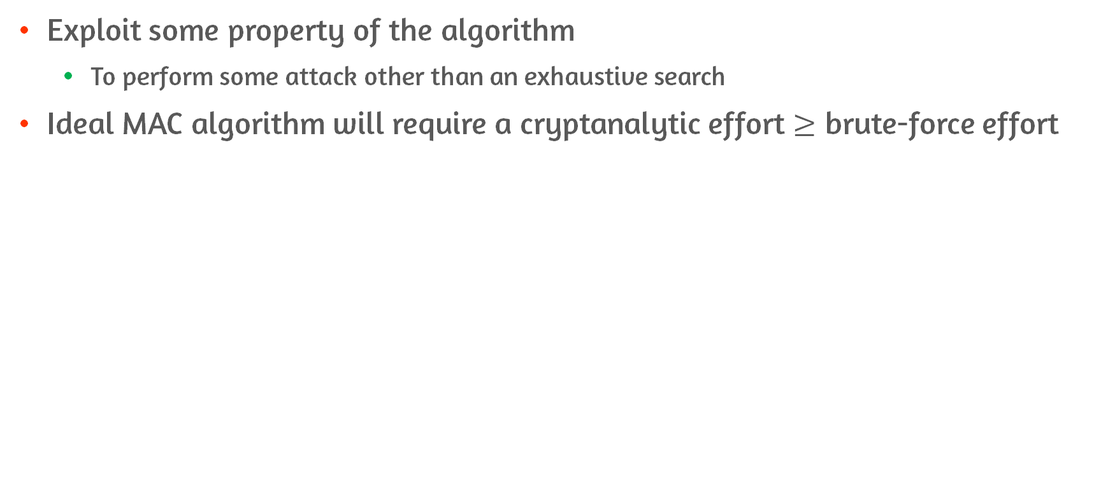
Cryptanalysis
Exploit some property of the algorithm
To perform some attack other than an exhaustive search
Ideal MAC algorithm will require a cryptanalytic effort $≥$ brute-force effort

Slide 30
12.5 MACs Based on Hash Functions: HMAC

Slide 31
What is Hash Based Message Authentication Code(HMAC)?
Motivations for MAC derived from cryptographic hash function
Hash functions (e.g., MD5 and SHA) generally execute faster than block cipher(e.g., DES)
Library code for hash functions is widely available
Hash function (e.g., SHA) was not designed for use as a MAC
Since not rely on a secret key
Incorporation of a secret key into an existing hash algorithm is “HMAC”
Design Objectives
Use available hash functions and allow easy replaceability
Preserve the original performance of the hash function

Slide 32
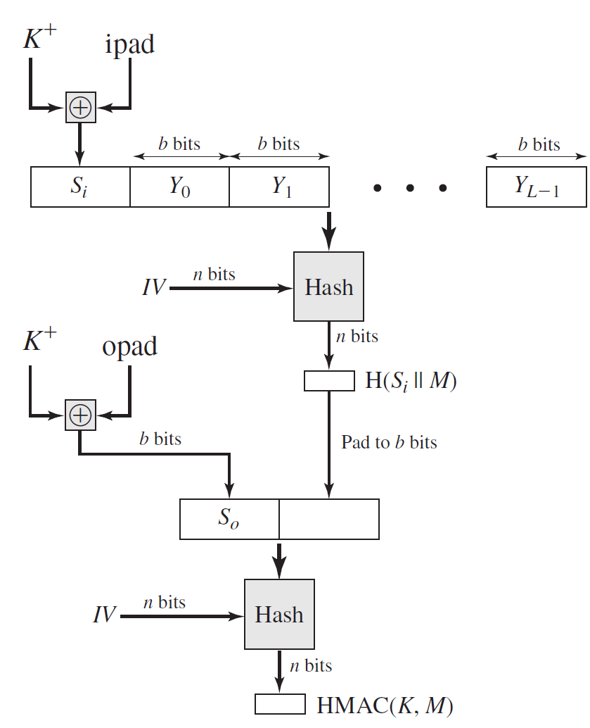
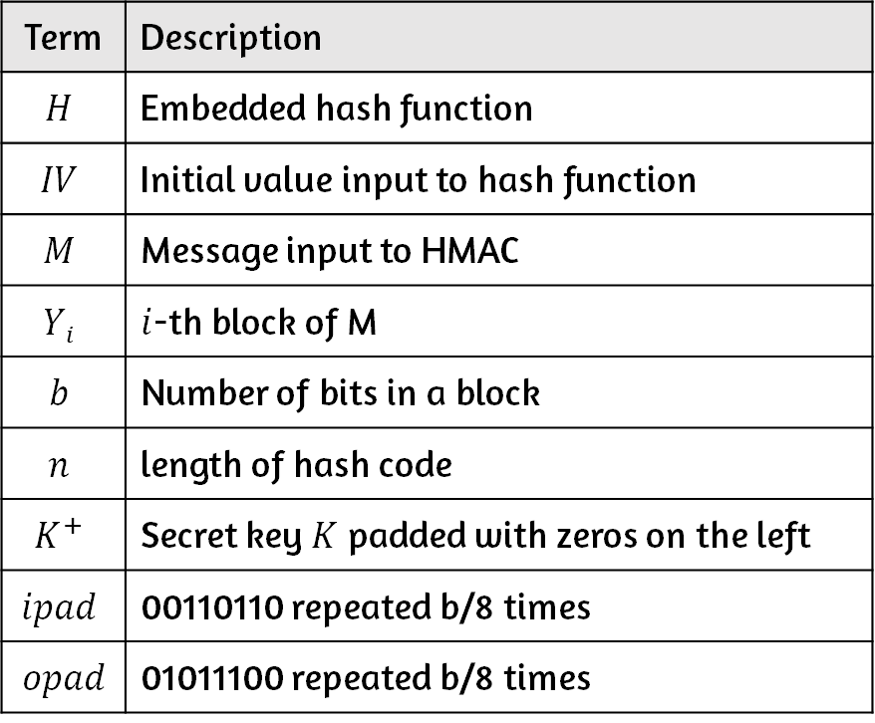
Terms of HMAC Algorithm
Term | Description
$$H$$ | Embedded hash function
$$IV$$ | Initial value input to hash function
$$M$$ | Message input to HMAC
$$Yi$$ | $i$-th block of M
$$b$$ | Number of bits in a block
$$n$$ | length of hash code
$$K^{+}$$ | Secret key $K$ padded with zeros on the left
$$ipad$$ | 00110110 repeated b/8 times
𝑜𝑝𝑎𝑑 | 01011100 repeated b/8 times

Slide 33
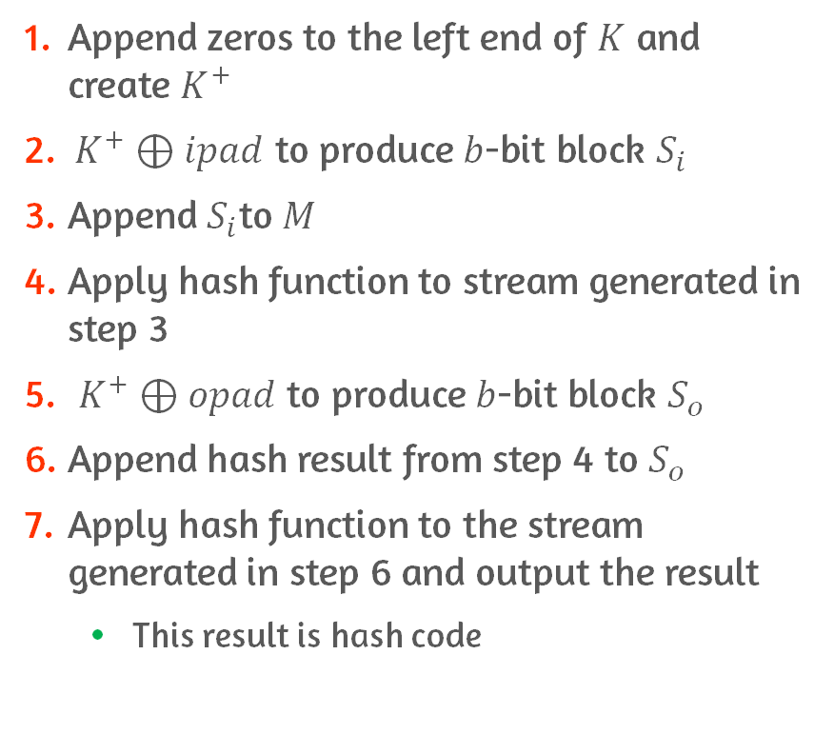
HMAC Algorithm
Append zeros to the left end of $K$ and create $K^{+}$
$K^{+}⊕ipad$ to produce $b$-bit block $S_{i}$
Append$S_{i}$to $M$
Apply hash function to stream generated in step 3
$K^{+}⊕opad$ to produce $b$-bit block $S_{o}$
Append hash result from step 4 to $S_{o}$
Apply hash function to the stream generated in step 6 and output the result
This result is hash code
Notes:
여기서 secret key K는 처음에 pad와 XOR되면서 ½ bit flipping의 효과
Hash함수를 거치면서 compression이 되고 그 결과 pseudorandom key를 가지게 됨

Slide 34
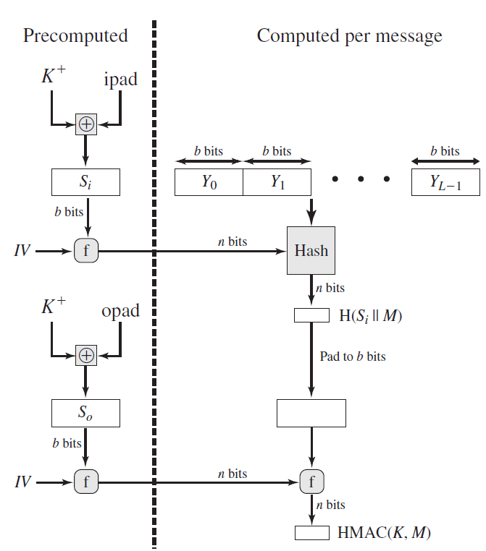
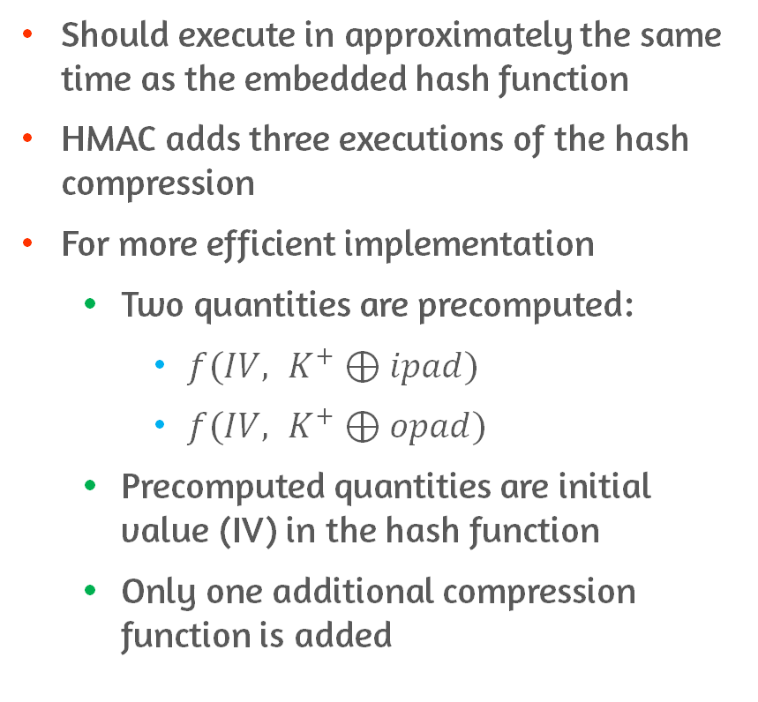
Execution of HMAC
Should execute in approximately the same time as the embedded hash function
HMAC adds three executions of the hash compression
For more efficient implementation
Two quantities are precomputed:
$f(IV, K^{+}⊕ipad)$
$f(IV, K^{+}⊕opad)$
Precomputed quantities are initial value (IV) in the hash function
Only one additional compression function is added

Slide 35
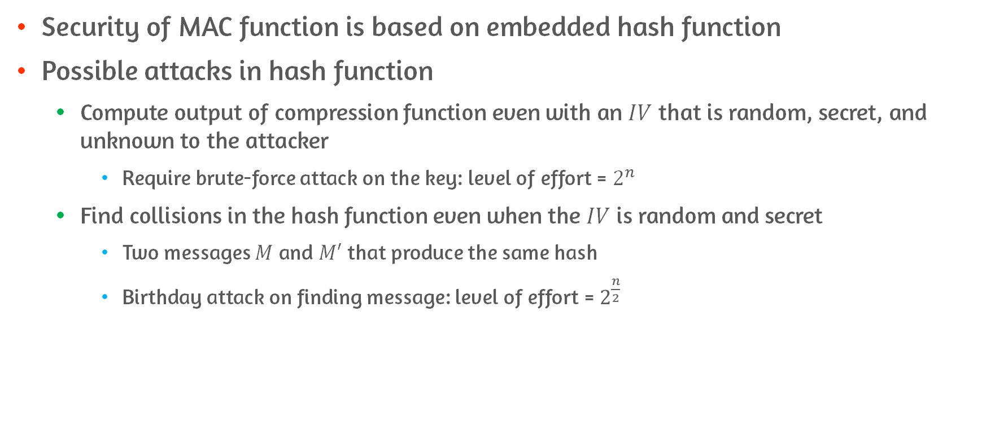
Security of HMAC
Security of MAC function is based on embedded hash function
Possible attacks in hash function
Compute output of compression function even with an $IV$ that is random, secret, and unknown to the attacker
Require brute-force attack on the key: level of effort = $2^{n}$
Find collisions in the hash function even when the $IV$ is random and secret
Two messages $M$ and $M′$ that produce the same hash
Birthday attack on finding message: level of effort = $2^{\frac{n}{2}}$
Notes:
Birthday attack관점에서 볼 때 128bit의 MD5를 쓰면 2^64번만 탐색하면 해당 메시지를 찾을 수 있다는 뜻
그러면 MD5가 HMAC으로 적합하지 않은 것이냐? No
- 기존 hash 알고리즘에서는 default IV를 알기 때문에 각 메시지에 대한 해시 값을 찾을 수 있었음
- HMAC 공격에서는 K를 모르기 때문에 offline에서 공격할 수 없음
그니까 같은 키로 생성되는 메시지와 코드를 관찰할 수 밖에 없음 – 이를 기반으로 해서 공격해야 함

Slide 36
12.6 MACs Based on Block Ciphers: DAA and CMAC
Data Authentication Algorithm(DAA) – obsolete
Cipher-Based Message Authentication(CMAC)

Slide 37
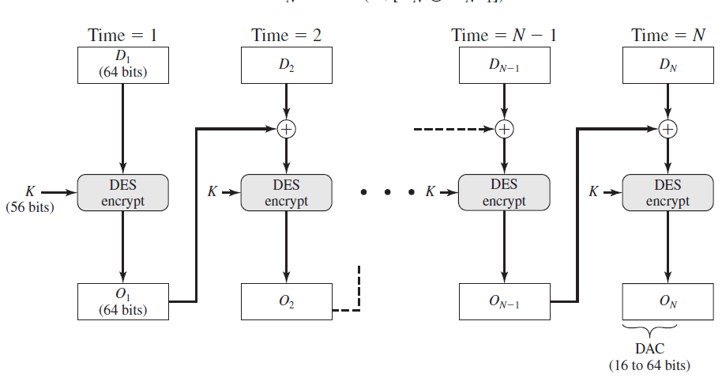
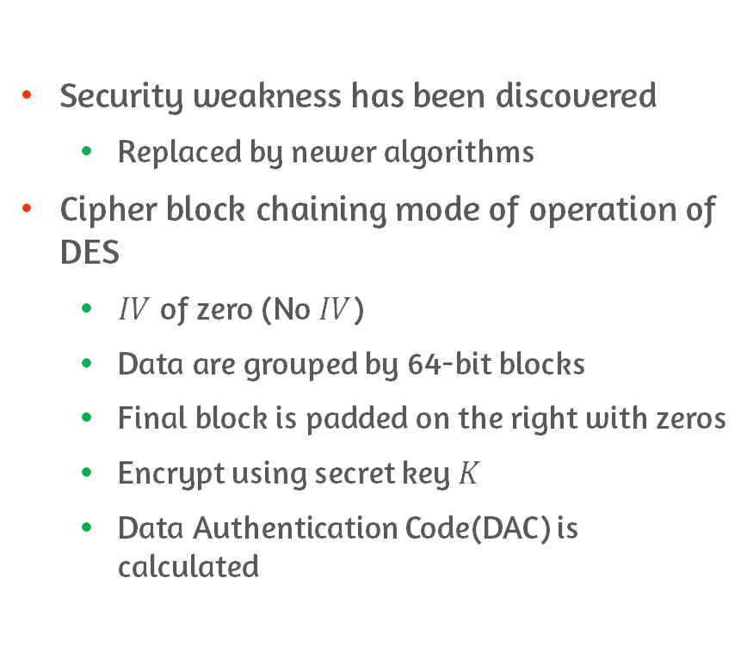
Data Authentication Algorithm(DAA)
Security weakness has been discovered
Replaced by newer algorithms
Cipher block chaining mode of operation of DES
$IV$ of zero (No $IV$)
Data are grouped by 64-bit blocks
Final block is padded on the right with zeros
Encrypt using secret key $K$
Data Authentication Code(DAC) is calculated

Slide 38
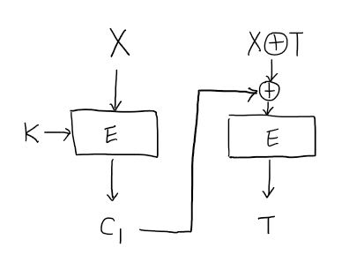
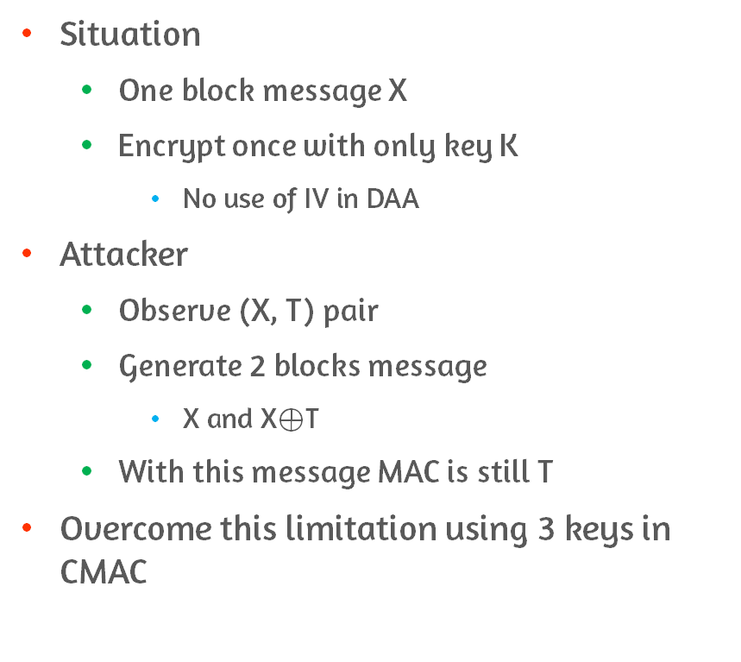
Limitation on DAA
Situation
One block message X
Encrypt once with only key K
No use of IV in DAA
Attacker
Observe (X, T) pair
Generate 2 blocks message
X and X$⊕$T
With this message MAC is still T
Overcome this limitation using 3 keys in CMAC

Slide 39
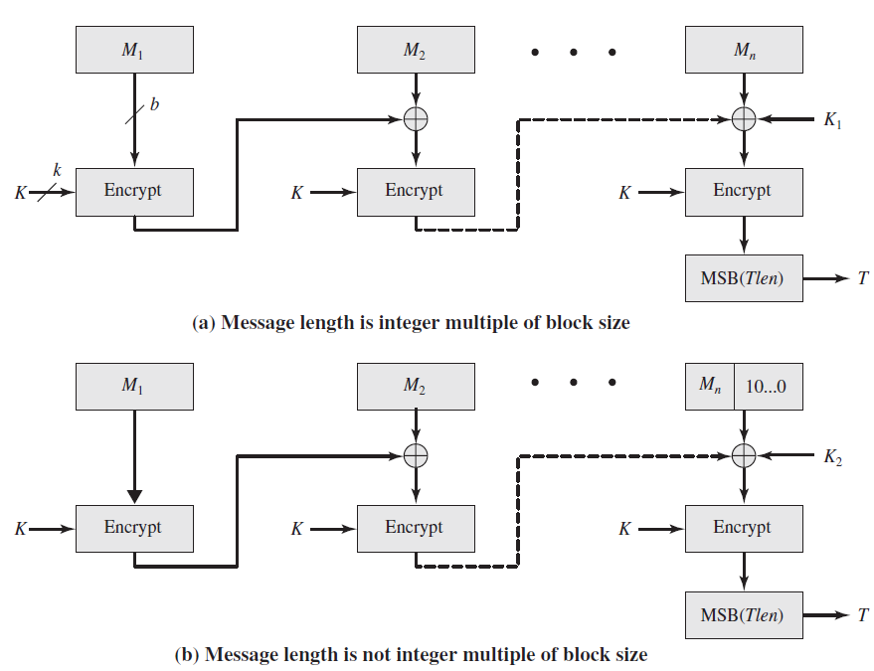
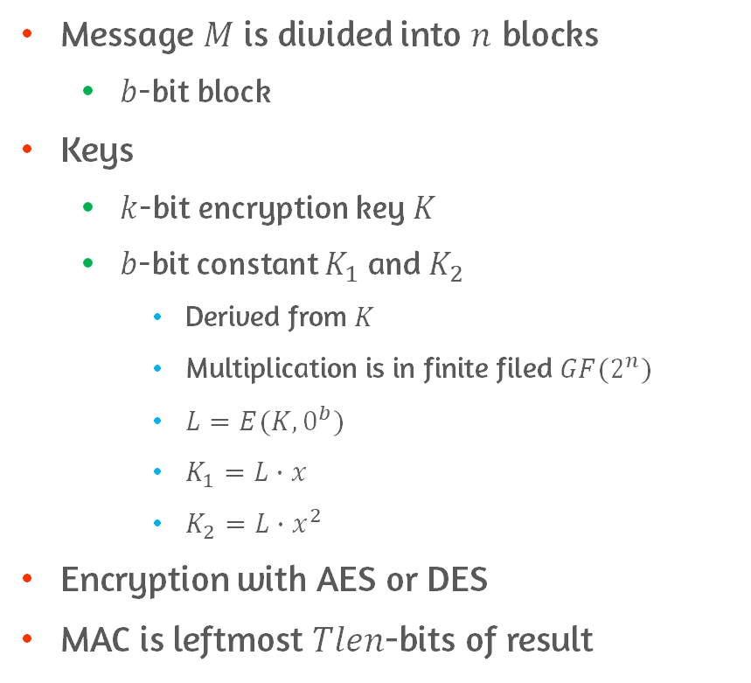
Cipher-Based Message Authentication Code(CMAC)
Message $M$ is divided into $n$ blocks
$b$-bit block
Keys
$k$-bit encryption key $K$
$b$-bit constant $K_{1}$ and $K_{2}$
Derived from $K$
Multiplication is in finite filed $GF(2^{n})$
$L=E(K, 0^{b})$
$K_{1}=L∙x$
$K_{2}=L∙x^{2}$
Encryption with AES or DES
MAC is leftmost $Tlen$-bits of result

Slide 40
12.7 Authenticated Encryption: CCM and GCM

Slide 41
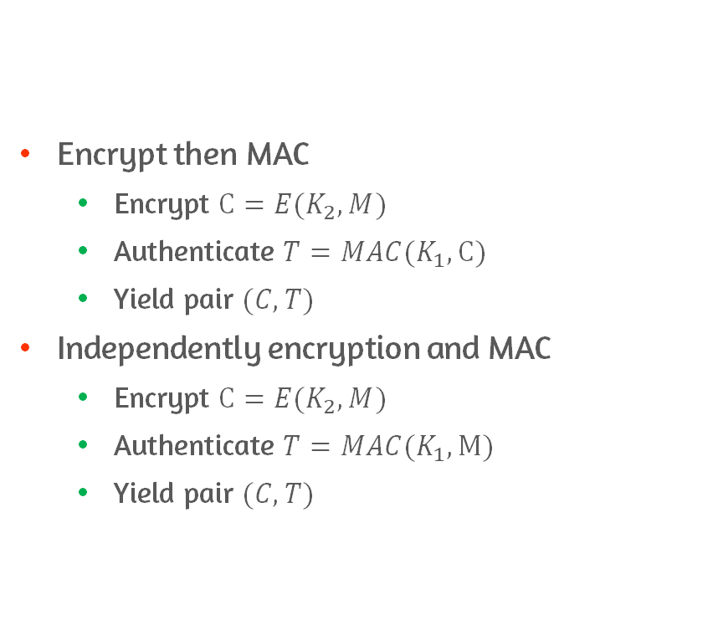
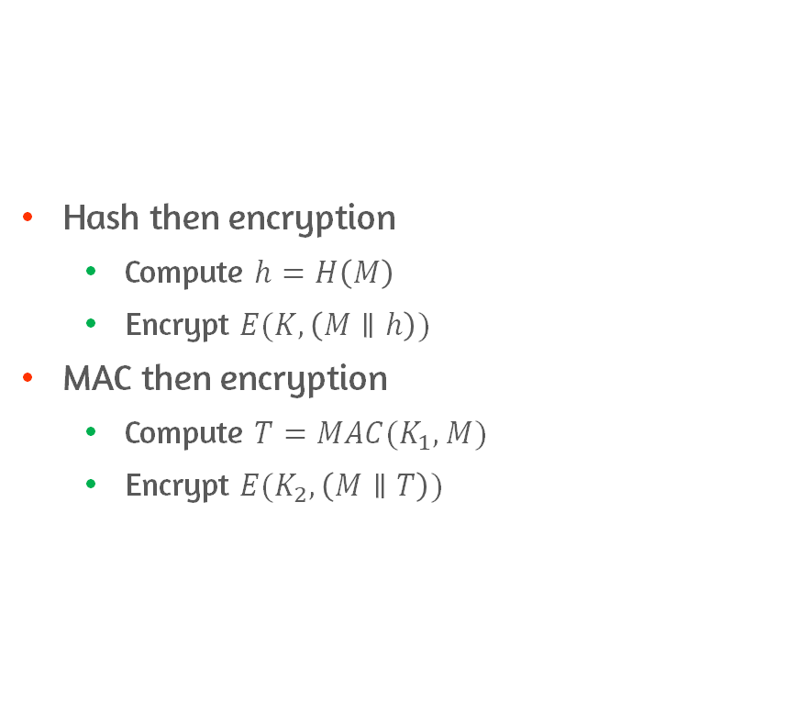
Authenticated Encryption
Hash then encryption
Compute $h=H\left(M\right)$
Encrypt $E(K, \left(M∥h\right))$
MAC then encryption
Compute $T=MAC(K_{1}, M)$
Encrypt $E(K_{2}, \left(M∥T\right))$
Encrypt then MAC
Encrypt $C=E(K_{2}, M)$
Authenticate $T=MAC(K_{1}, C)$
Yield pair $(C, T)$
Independently encryption and MAC
Encrypt $C=E(K_{2}, M)$
Authenticate $T=MAC(K_{1}, M)$
Yield pair $(C, T)$

Slide 42
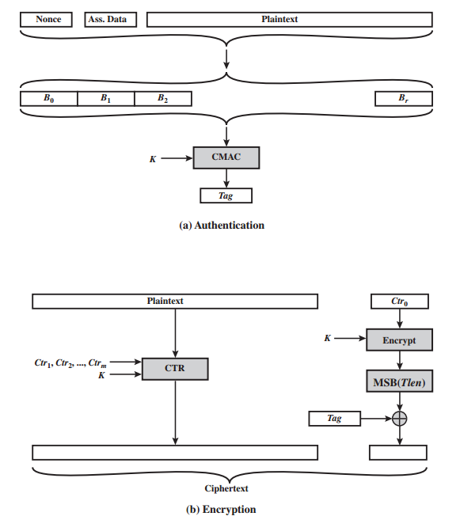
CCM
Encrypt then MAC
Associated data
E.g., protocol header
Nonce
Unique value for transaction
Above inputs are formatted as a sequence of blocks

Slide 43
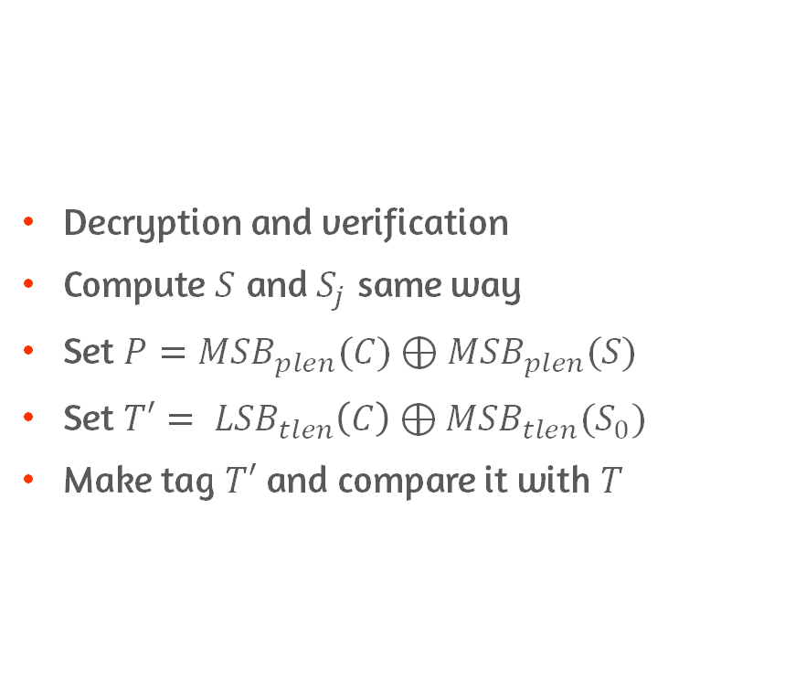
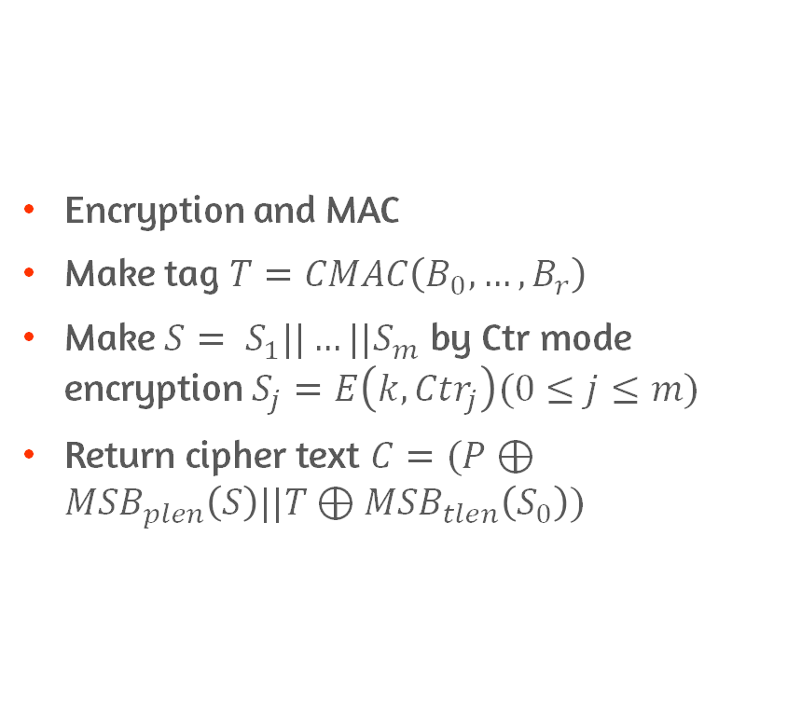
Encryption and Decryption
Encryption and MAC
Make tag $T=CMAC\left(B_{0},…,B_{r}\right)$
Make $S= S_{1}||…||S_{m}$ by Ctr mode encryption $S_{j}=E\left(k,{Ctr}_{j}\right)(0≤j≤m)$
Return cipher text $C=(P⊕{MSB}_{plen}\left(S\right)||T⊕{MSB}_{tlen}\left(S_{0}\right))$
Decryption and verification
Compute $S$ and $S_{j}$ same way
Set $P={MSB}_{plen}(C)⊕{MSB}_{plen}(S)$
Set $T′= {LSB}_{tlen}\left(C\right)⊕{MSB}_{tlen}(S_{0})$
Make tag $T′$ and compare it with $T$

Slide 44
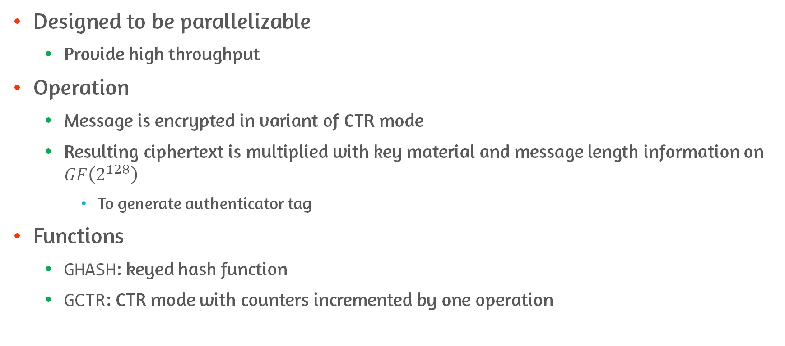
GCM
Designed to be parallelizable
Provide high throughput
Operation
Message is encrypted in variant of CTR mode
Resulting ciphertext is multiplied with key material and message length information on $GF\left(2^{128}\right)$
To generate authenticator tag
Functions
GHASH: keyed hash function
GCTR: CTR mode with counters incremented by one operation

Slide 45
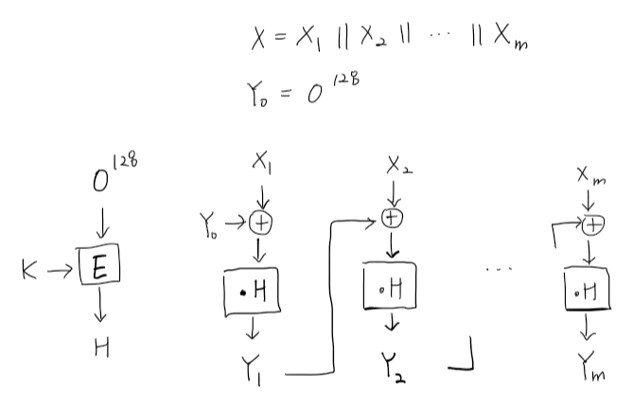
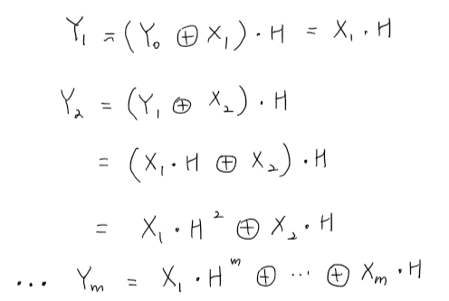
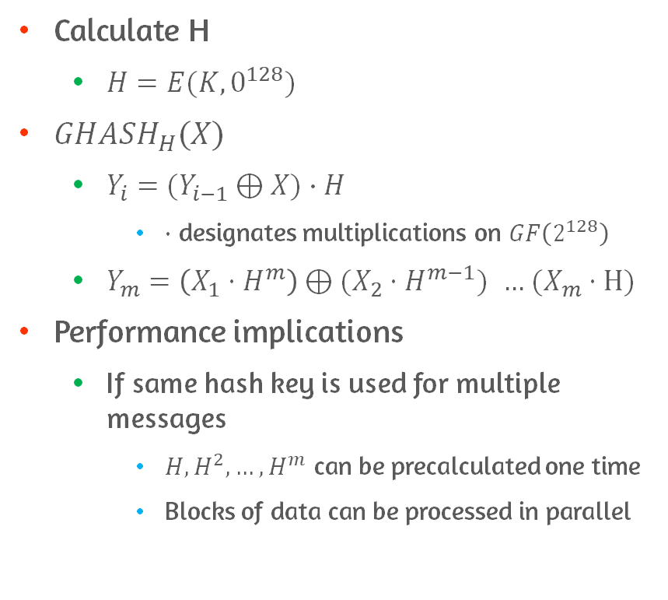
Function of GCM: GHASH
GHASH
Calculate H
$H=E(K, 0^{128})$
${GHASH}_{H}(X)$
$Y_{i}=(Y_{i−1}⊕X)∙H$
$∙$ designates multiplications on $GF\left(2^{128}\right)$
$Y_{m}=\left(X_{1}⋅H^{m}\right)⊕(X_{2}⋅H^{m−1})$ $…$ $(X_{m}⋅H)$
Performance implications
If same hash key is used for multiple messages
$H, H^{2}, …, H^{m}$ can be precalculated one time
Blocks of data can be processed in parallel
Calculate H

Slide 46
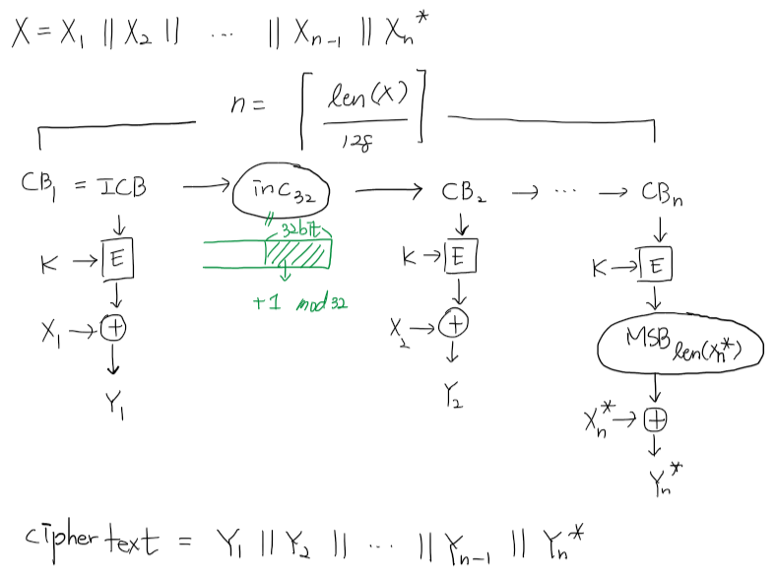
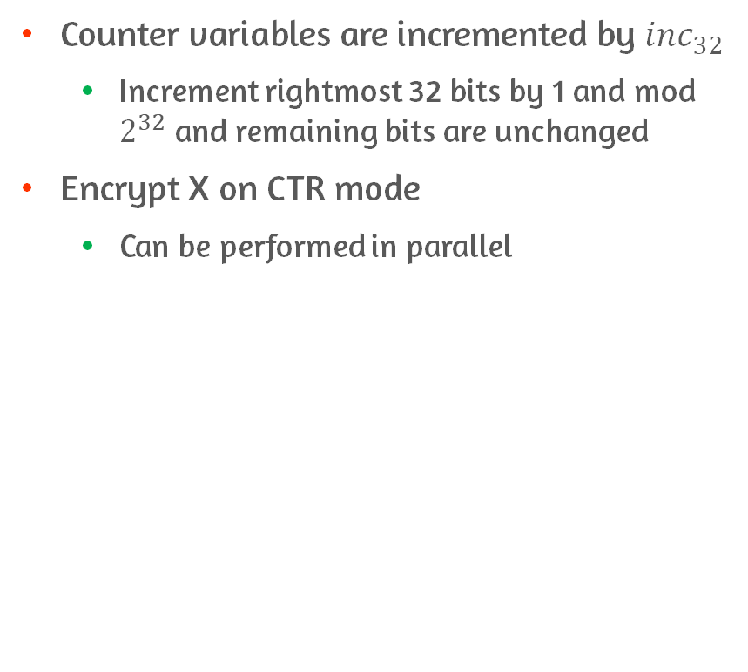
Function of GCM: GCTR
Counter variables are incremented by ${inc}_{32}$
Increment rightmost 32 bits by 1 and mod $2^{32}$ and remaining bits are unchanged
Encrypt X on CTR mode
Can be performed in parallel

Slide 47
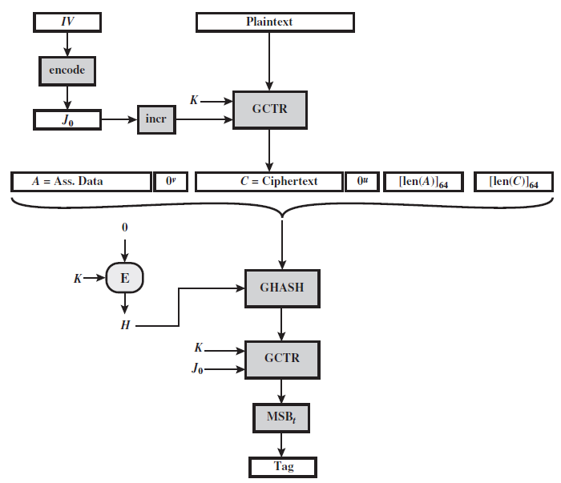
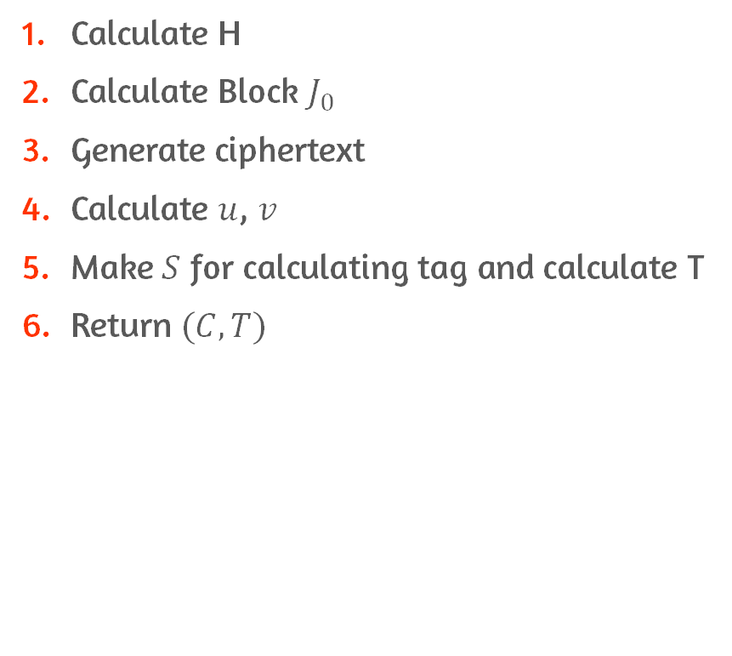
Operation of GCM
❷
❸
Calculate H
Calculate Block $J_{0}$
Generate ciphertext
Calculate $u$, $v$
Make $S$ for calculating tag and calculate T
Return $(C, T)$
❹
❶
❺

Slide 48
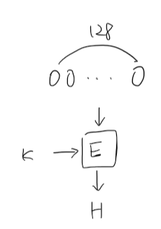
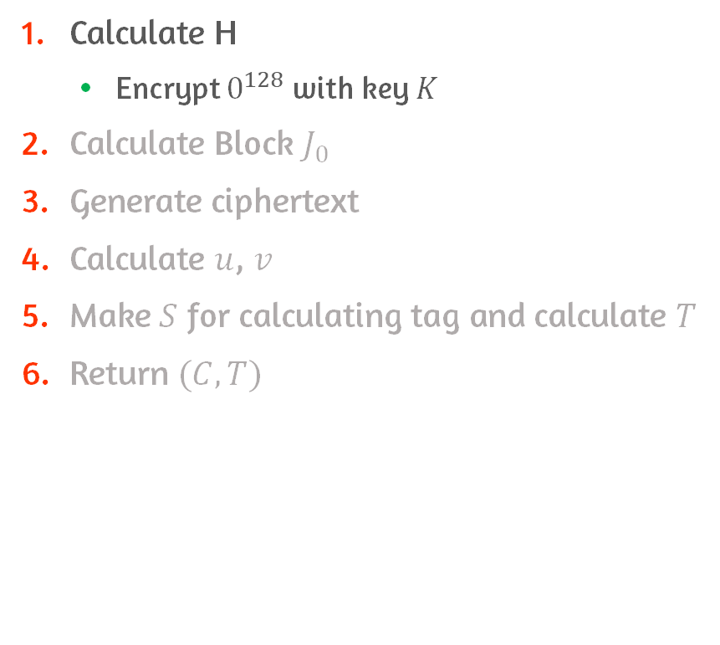
Operation of GCM
Calculate H
Encrypt $0^{128}$ with key $K$
Calculate Block $J_{0}$
Generate ciphertext
Calculate $u$, $v$
Make $S$ for calculating tag and calculate $T$
Return $(C, T)$

Slide 49
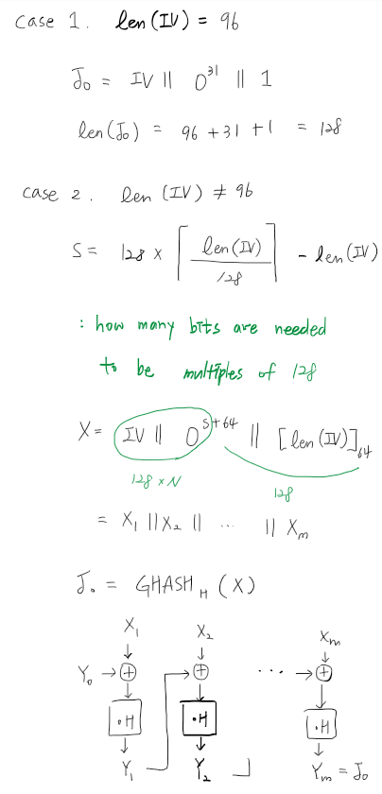
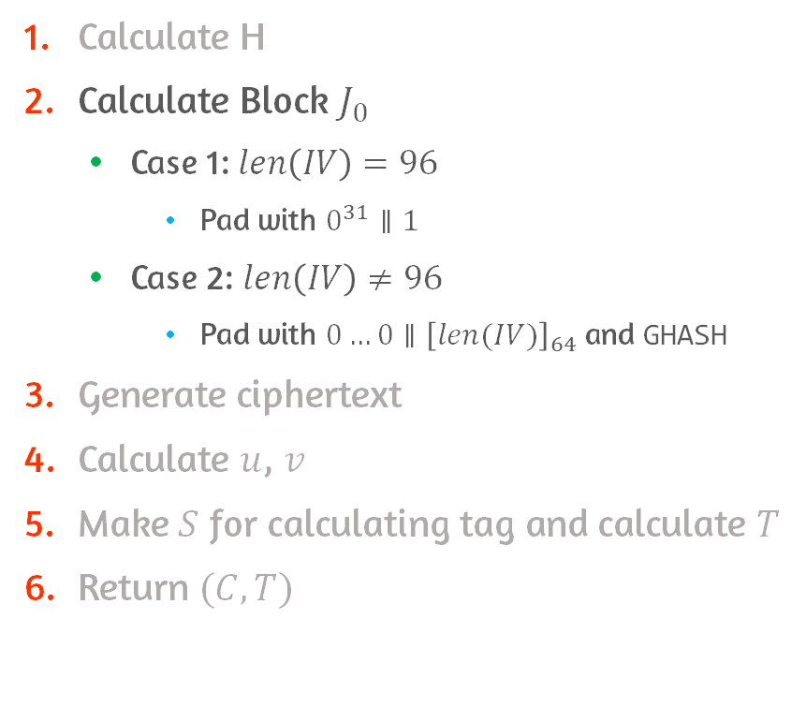
Operation of GCM
Calculate H
Calculate Block $J_{0}$
Case 1: $len\left(IV\right)=96$
Pad with $0^{31}∥1$
Case 2: $len\left(IV\right)≠96$
Pad with $0…0∥{\left[len(IV)\right]}_{64}$ and GHASH
Generate ciphertext
Calculate $u$, $v$
Make $S$ for calculating tag and calculate $T$
Return $(C, T)$

Slide 50
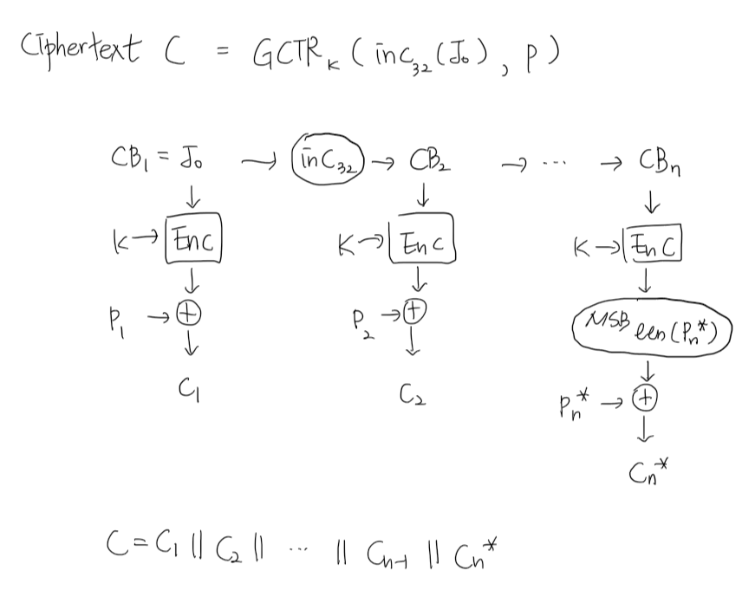
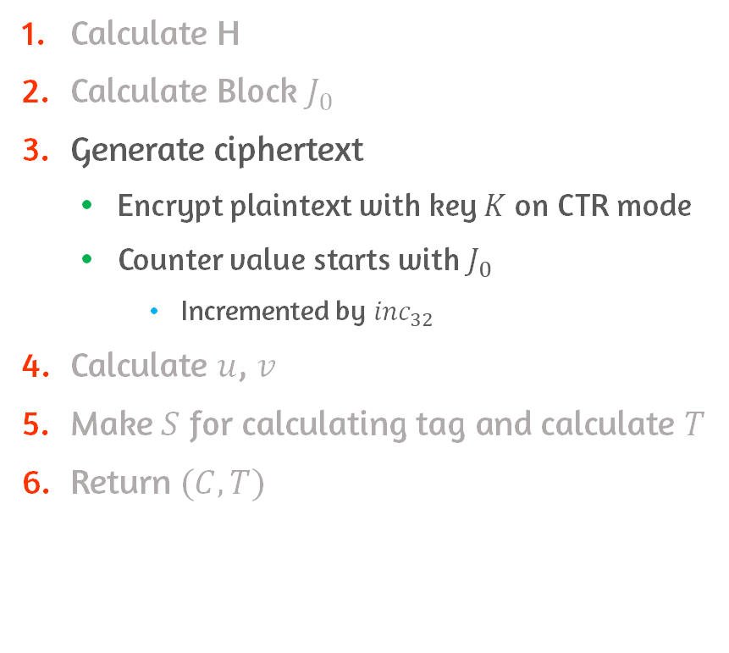
Operation of GCM
Calculate H
Calculate Block $J_{0}$
Generate ciphertext
Encrypt plaintext with key $K$ on CTR mode
Counter value starts with $J_{0}$
Incremented by ${inc}_{32}$
Calculate $u$, $v$
Make $S$ for calculating tag and calculate $T$
Return $(C, T)$

Slide 51
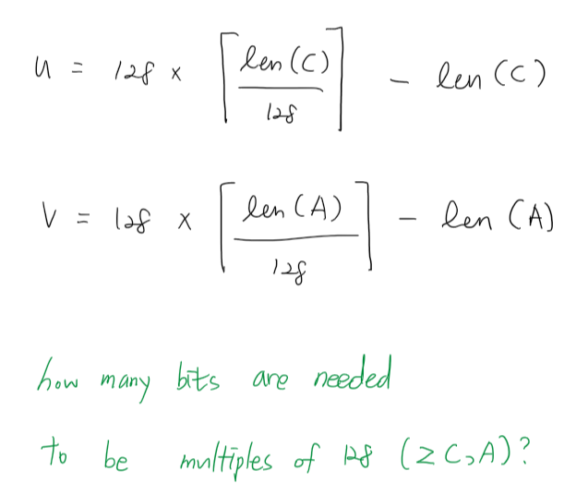
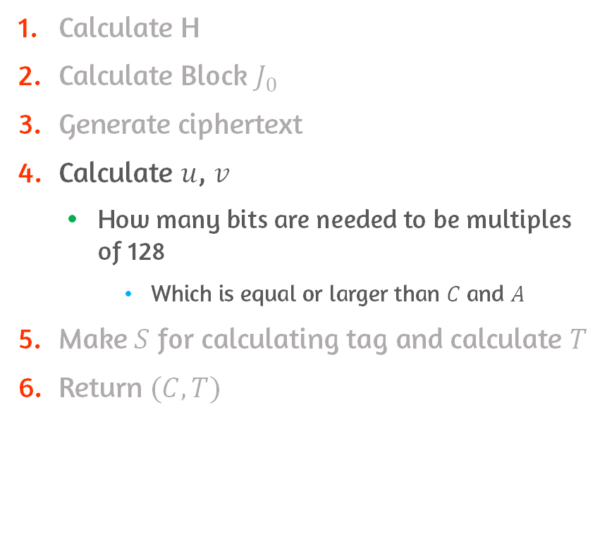
Operation of GCM
Calculate H
Calculate Block $J_{0}$
Generate ciphertext
Calculate $u$, $v$
How many bits are needed to be multiples of 128
Which is equal or larger than $C$ and $A$
Make $S$ for calculating tag and calculate $T$
Return $(C, T)$

Slide 52
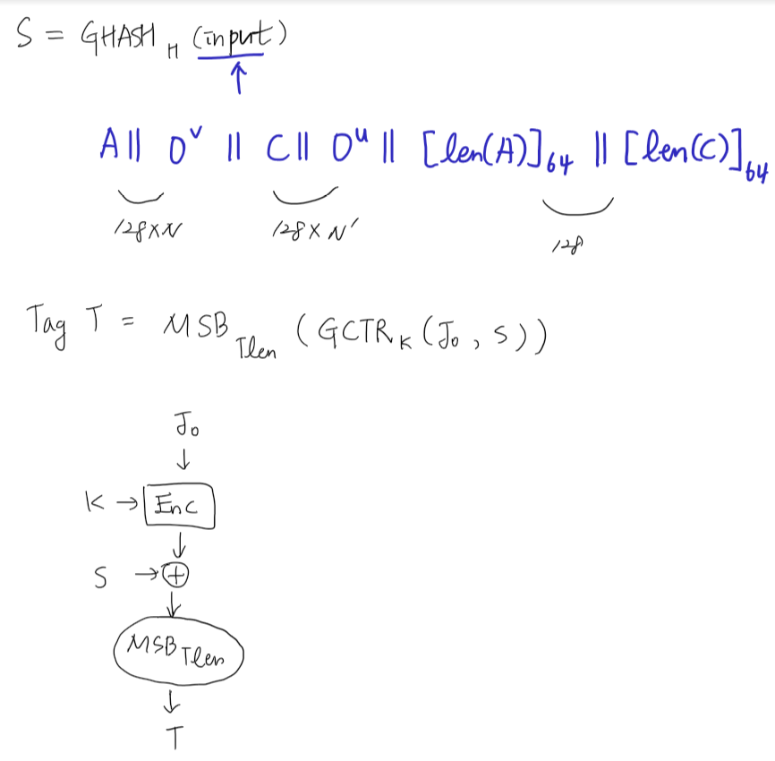
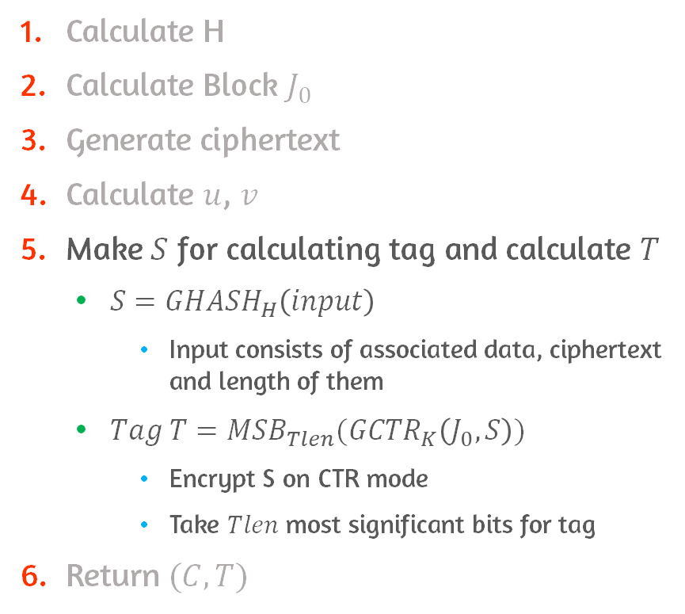
Operation of GCM
Calculate H
Calculate Block $J_{0}$
Generate ciphertext
Calculate $u$, $v$
Make $S$ for calculating tag and calculate $T$
$S={GHASH}_{H}\left(input\right)$
Input consists of associated data, ciphertext and length of them
$Tag T={MSB}_{Tlen}({GCTR}_{K}\left(J_{0}, S\right))$
Encrypt S on CTR mode
Take $Tlen$ most significant bits for tag
Return $(C, T)$

Slide 53
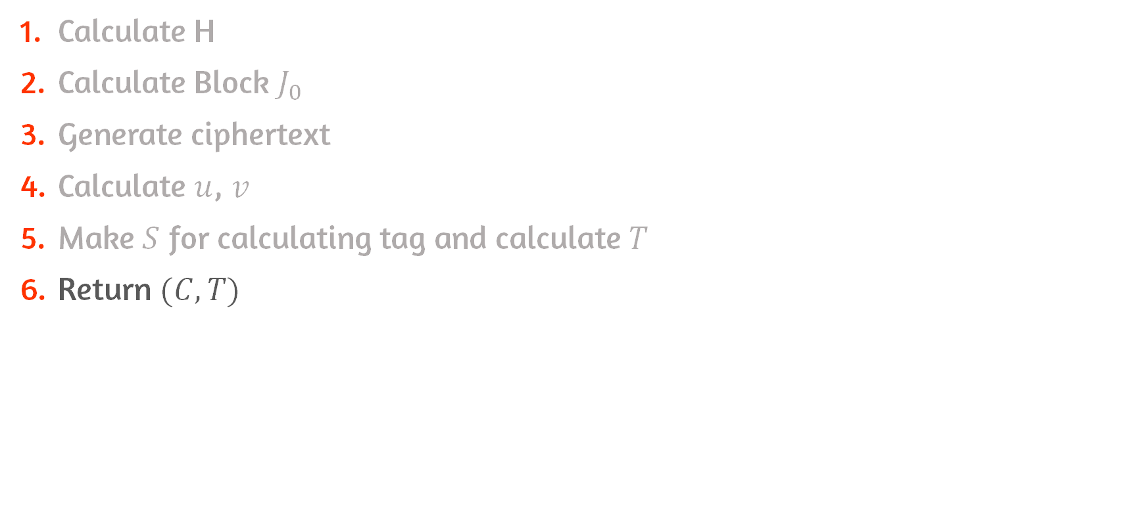
Operation of GCM
Calculate H
Calculate Block $J_{0}$
Generate ciphertext
Calculate $u$, $v$
Make $S$ for calculating tag and calculate $T$
Return $(C, T)$

Slide 54
Conclusion
List and explain possible attacks that are relevant to message authentication
Overview the message authentication functions
Understand the Requirements and security of MAC
HMAC
DAA and CMAC
CCM and GCM

